Slide 1
RNS INSTITUTE OF TECHNOLOGY
BENGALURU - 98
DEPARTMENT OF INFORMATION SCIENCE & ENGINEERING
Final Year Project Work Presentation
Facial Emotion Detection for Enhanced Learning of human emotions for Autistic Children
Candidates
Akshay P: 1RN19IS018 Athira Rajeev: 1RN19IS041
Deethya J Reddy: 1RN19IS055
S Rakshitha: 1RN19IS125
Internal Guide
Dr. S Sathish Kumar
Prof, Dept of ISE, RNSIT
Panel
Ms. Aishwarya G
Asst. Prof,
Dept of ISE, RNSIT

Slide 2
AGENDA
Abstract
Introduction
Literature Review
Analysis
System Design
Implementation
Testing
Discussion of Results
National Conference Paper
Conclusion and Future Enhancements
References
Q & A

Slide 3
ABSTRACT
Facial Emotion recognition is a challenging problem in the field of image analysis and computer vision. Deep learning, especially CNN supports the implementation of FR technology.
ASD (Autism Spectrum Disorder) is a neurodevelopmental disorder which presents itself with impairments in social interaction and communication.
The existing system of ASD therapy, namely occupational therapy, applied behavioral analysis and sensory integration therapy are manual processes and are not found to be truly effective methods.
Artificial intelligence techniques support the development of therapy and intervention tools and help in achieving significant improvement in an ASD-affected person’s social behaviour.
The proposed system for facial expression recognition provides a personalized interface to help children with autism identify and understand human emotions.

Slide 4
INTRODUCTION
Background
In overall communication, the involvement of non-verbal communication is significant, around 55% to 93%.
Facial recognition system should be able to instantly detect a face in an image or a video. This involves extracting its features and then recognising it, regardless of lighting, expression, illumination, ageing, transformations and pose.
Autism Spectrum Disorder (ASD), commonly referred to as autism, is characterized by persistent deficits in social communication and social interaction with these symptoms being shown in the early developmental period.
Although autism is not a curable disorder, the treatments can help decrease the social deficits associated with ASD.

Slide 5
INTRODUCTION
Existing system
Treatment includes occupational therapy, applied behavioral analysis, sensory integration therapy, etc. These therapies are manual processes, which use tangible products with fixed settings and which today represent a danger due to the possible transmission of diseases.
They sometimes do not generate motivation in patients, but it makes them feel intimidated.
The methods to assess Emotional Regulation in individuals with ASD are based on observations are affected by difficult-to-interpret emotions without defining the context of the child’s baseline behaviors and emotional expressions.
Artificial intelligence techniques have to be applied to improve the results obtained in these therapies.

Slide 6
INTRODUCTION
Proposed System
Develop non-invasive technological frameworks which can be applied to extract facial measurements in a non-invasive way.
This option does not seek to eliminate the specialists from the therapy, but to facilitate their activities to achieve concentration in other exercises that could be more critical.
Proposed system for facial expression recognition provides a personalized interface to help children with autism identify and understand human emotions. Human emotions are basically represented in different classes of emotions, for example, happy, sad, natural, anger, surprise, hatred and fear.
There are three stages in detecting emotions, selection of images, database training, and emotions classification. The classification of emotions is done using DCNN classifier and interfaced with an application.

Slide 7
LITERATURE REVIEW
 | Title Of the Paper | Year Of Publishing | Model | Datasets | Performance measure | Values | Future Enhancements
1 | FaceNet2ExpNet: Regularizing a Deep Face Recognition Net for Expression Recognition | September 2016 | FaceNet2ExpNet algorithm in CNN | CK+, Oulu-CASIA, TFD, and SFEW | Accuracy | 96.8% | Apply this training method to other domains with small datasets.
2 | Facial emotion recognition-based learner engagement detection system in online learning | May 2022 | Deep learning models | JAFFE data set, CK + data set, BU3DF database | Accuracy | DCBiLSTM - 99.6%, Dist-based – 98%, CNN - 97.01%, SBN-CNN - 96.8%, Rule-based – 95% | Expand the database and develop powerful deep learning architectures capable of recognizing all basic and secondary emotions.
3 | Adaptively Learning Facial Expression Representation via C-F Labels and Distillation | January 2021 | adaptive supervised objective named AdaReg loss | RAF-DB, AffectNet, FER2013, FERPlus | Accuracy | 81.83% with KTN 80.23% with STSN | Improving accuracy of KTN
4 | Learning to Amend Facial Expression Representation via De-albino and Affinity | October 2021 | Amending Representation Module (ARM). | AffectNet, RAF-DB, SFEW | Accuracy | 90.42% with RAF-DB 65.2% with AffectNet 58.71% with SFEW | Improving accuracy of model with different datasets Improve generalization
5 | Emo-mirror: a proposal to support emotion recognition in children with autism spectrum disorders | September 2021 | CNN (ResNet 50) | FER2013, CK+ | Accuracy | In ResNet 50: 89.9% with CK+ 72.3% with FER2013 W93.3% with CK+ | Persforming case and control study of utility of prototype among childern with ASD and children without
6 | Facial Expression Recognition with CNN-LSTM | January 2021 | CNN-LSTM | JAFFE | Accuracy | 86.42% with JAFFE | Training network with more data, more filters, and more depth to improve the accuracy in facial expression recognition.

Slide 8
LITERATURE REVIEW
 | Title Of the Paper | Year Of Publishing | Model | Datasets | Performance measure | Values | Future Enhancements
7 | Learning vision transformer with squeeze and excitation for facial expression recognition | Jul 2021 | Vision Transformer with a Squeeze and Excitation (SE) block | CK+, JAFFE,RAF-DB and SFEW | Accuracy | 99.80% with CK+ , 54.29% with SFEW | Address the temporal aspect for a more competitive task like micro-expressions recognition
8 | Learn From All: Erasing Attention Consistency for Noisy Label Facial Expression Recognition | Sep 2022 | Erasing Attention Consistency (EAC) method | RAF-DB ,FERPlus , AffectNet | Accuracy | 89.99% with RAF-DB , 65.32% with AffectNet | Improvise the model to gain more accuracy than KTN
9 | Optimal Facial Feature Based Emotional Recognition Using Deep Learning | Sep 2022 | ECNN | FER2013 | Accuracy | 97% | Adding more features, identifying ten different types of facial emotions, and researching automatic facial emotion identification
10 | Facial Emotion Detection And Recognition | May 2022 | CNN & Haar classifier | KDEF,JAFFE | Accuracy | 97.98% | Include emotion recognition from speech or body motions in order to address emerging industrial applications.
11 | Facial Emotion Recognition Using Transfer Learning in the Deep CNN | Apr 2021 | DenseNet-161 | KDEF,JAFFE | Accuracy | 96.51% with KDEF , 99.52% with JAFFE | The idea of facial emotion recognition may be extended to emotion recognition from speech or body movements to cover emerging industrial applications.
12 | Emotion Recognition Based on Facial Expressions Using Convolutional Neural Network (CNN) | May 2021 | CNN | iCV MEFED(Multi-Emotion Facial Expression Dataset) | Accuracy | 85% | Different approach by taking into consideration “Action Units” to detect as features the movement of the muscles of the face and then to feed the CNN.

Slide 9
LITERATURE REVIEW
Sl. No | Title | Year | Model | Dataset | Performance Measure | Values | Future Enhancements
13 | Facial Emotion Recognition Using a Novel Fusion of Convolutional Neural Network and Local Binary Pattern in Crime Investigation | September 2022 | CNN | JAFFE data set, CK + data set | Accuracy | 96.8% | Investigate particular psychological characteristics.
14 | Methods for Facial Expression Recognition with Applications in Challenging Situations | May 2022 | Deep learning models | JAFFE data set, CK + data set, BU3DF database | Accuracy | DCBiLSTM - 99.6%, Dist-based – 98%, CNN - 97.01%, SBN-CNN - 96.8%, Rule-based – 95% | Expand the database and develop powerful deep learning architectures capable of recognizing all basic and secondary emotions.
15 | Face Recognition and Identification using Deep Learning Approach | 2020 | Deep learning models | CK + data set | Accuracy | Recognizing image - 91.7%, Recognizing real-time video - 86.7% | Adding more training images which are captured in low light intensity to generate the face classifier.
16 | FECTS: A Facial Emotion Cognition and Training System for Chinese Children with Autism Spectrum Disorder | January 2022 | CNN | CARS Assessment | Accuracy | 74.78 | Improve the recognition rate of fear expressions using the DeepLook algorithm. Cooperate with more autism rehabilitation institutions and recruit more autistic children from different cultural contexts for clinical tests.
17 | Facial Emotion Recognition for Autism Children | May 2020 | CNN | A dataset containing samples of facial images | Predict age, gender and emotion, | Male – predicted value < 0.5 Female – predicted value > 0.5 | Expand the database by adding more training images.
18 | Emotion Detection of Autistic Children Using Image Processing | 2019 | SVM, ANN | A dataset containing images of autistic children | Accuracy | SVM – 90% , ANN – 70% | Use other feature extraction techniques. Implement the prediction of age and gender from facial expressions. Develop model for ethnic prediction.

Slide 10
LITERATURE REVIEW
 | Title Of the Paper | Year Of Publishing | Model | Datasets | Performance measure | Values | Future Enhancements
19 | Challanges in Representation Learning: A report on three machine learning contests | 2013 | OpenCV, SVM | BBL-2013, FER-2013 | Accuracy | 68% | Making Use of CNN to get a better accuracy Score
20 | Covariance Pooling for Facial Expressoin Regression | 2018 | MTCNN | RAF, SFEW | Accuracy | 89.99% with RAF , 58% with SFEW | Using Gaussian Matrix after Covariance Matrix in order to improve the effectiveness of second-order statistics.
21 | Exploring Emotion Features and Fusion Strategies for Audio - Video Emotion Recognition | 2020 | CNN(VGGFace, ResNet18, IR50), FBP(Factorized Bilinear Pooling) | AffectNet, RAF-DB, FER+, AFEW | Accuracy | 89.25% | Applying more Feature Enhancement Strategies to the extracted Basic Feature and then get the average of the accuracy obtained from those enhancement so as to improve the models Accuracy
22 | Facial Emotion Recognition Using Convolution Neural Networks (FERC) | 2020 | CNN | Caltech faces, NIST Database | Accuracy | 96% | Using this model as a base and to include a deep learning model like lstm to increase its accuracy and hence will be applicable for its use in other fields

Slide 11
ANALYSIS
Problem Identification
The existing Facial Emotion Recognition(FER) system lacks to provide consistent accuracy.
The existing system uses both images and videos in order to reveal information on one’s emotional state which at times may be faulty.
The emotions Surprise, Neutral Emotion, and Sadness are more difficult to recognize as compared to others like happiness, anger, disgust and fear.
The existing system can not be used along with other models for its better application i.e., lack of interoperability.

Slide 12
ANALYSIS
Objectives
To make use of CNN model for FER along with another deep learning model to provide better accuracy score.
To train the model to significantly distinguish between different emotions more consistently.
To make the model usable with respect to its other applications like Mental health monitoring, Education, helping people suffering with ASD (Autistic Spectrum Disorder) to identify emotions.

Slide 13
ANALYSIS
Methodology
Applying CNN and FER algorithm
Making Use of DCNN deep learning model
Model prediction and deployment
Connecting the model to a front end application
Make application determine emotion

Slide 14
ANALYSIS
System requirement specification
Hardware requirements
Processor |  | Intel Core i5 9500E
Processor Speed |  | 2.10 Ghz
RAM |  | 8 GB DDR4
Monitor Resolution |  | 1336*768 or 1280*1024 or 1980*1080
Software requirements
Operating System |  | Windows 7 (32 Bit) or later.
Web browser |  | Any browser (Preferably Google Chrome or Brave)
Framework |  | React.js, Solidity Pragma.
Software |  | Metamask Wallet, Testnet Faucet
Programming Language |  | Python, Html, Css, Javascript

Slide 15
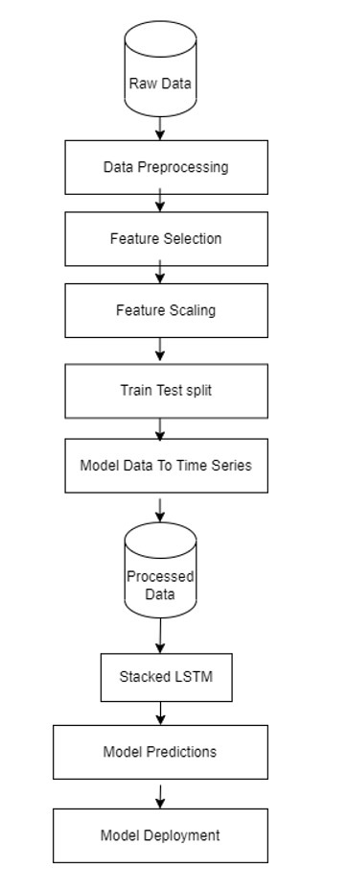
System Design
System architecture
DCNN Model

Slide 16
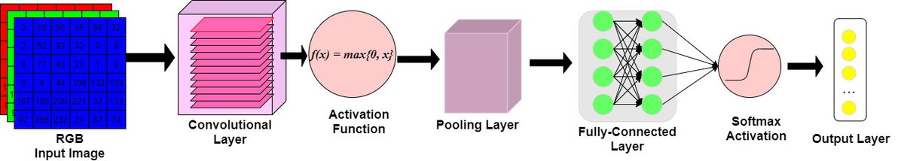
System Design
DCNN Architecture

Slide 17
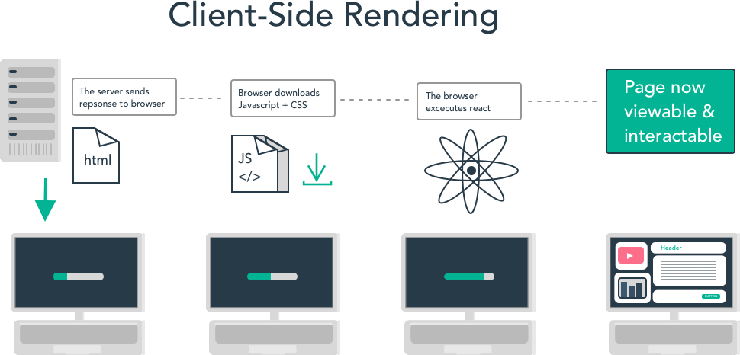
System Design
Web architecture

Slide 18
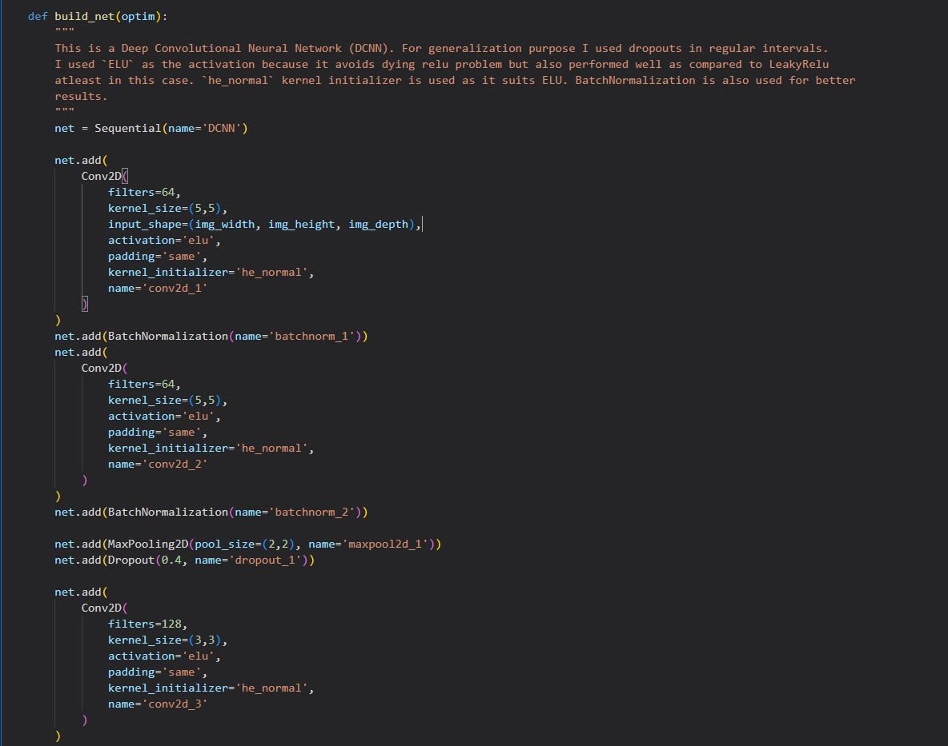
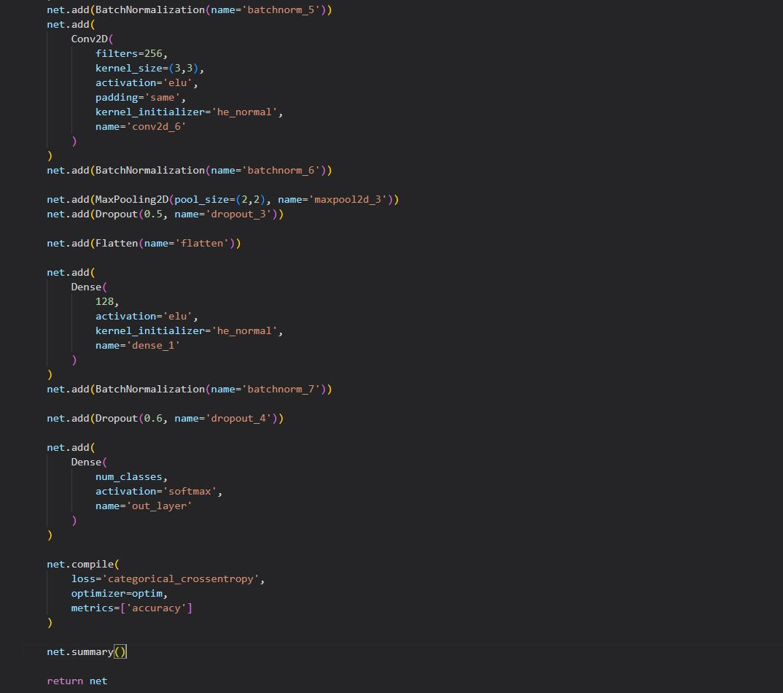
Implementation

Slide 19
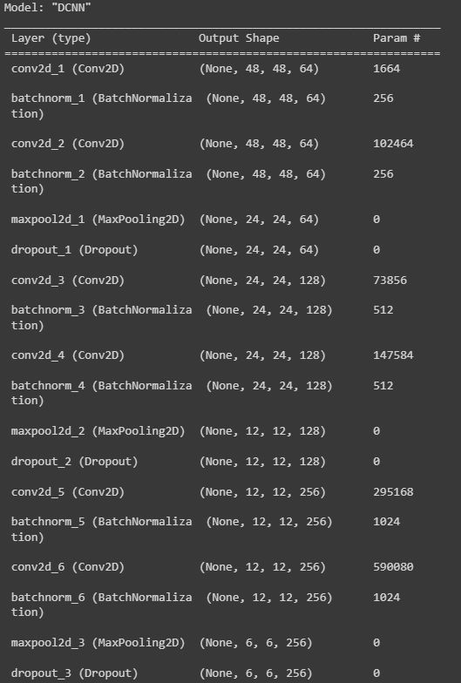
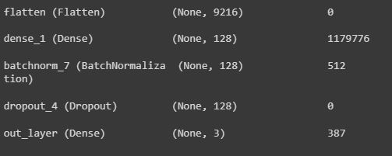
Implementation

Slide 20
Testing
Unit Testing
Unit Testing
Test Case No. | Description | Test Steps | Expected Results | Actual Results | Pass/Fail
1 | Data Loading Test: Test if dataset is loaded properly and parsed into required format | Check if loaded dataset has same number of emotions | If there are 7 unique emotions specify each emotion using dictionary | 7 Unique emotions are found and Each emotion value has been specified | Pass
2 | Image Size: Test if the size of the image is 48*48 pixel size | Check if the image size is 48*48 | Display 48 as the pixel length | 48 is displayed as length of pixel verifying the image size as 48*48 | Pass

Slide 21
Testing
3 | Irrespective of the input image format store output in .h5 format | Check if .h5 file is created in the output folder after training is done | Output folder contains .h5 file | .h5 file is created in output folder | Pass
4 | Depending on model different optimizers, callbacks are used for training | Use different optimized and callbacks based on model | Accuracy values improves based on the optimizers and callbacks used | Accuracy shows improvement based on the optimizers and callbacks that are used | Pass
5 | Load the pre-trained model(.h5 file) into open cv to predict emotion | Check if the pre-trained model is determining the emotion | Based on the pre-trained model the emotion is detected | Emotions detected as per the loaded pre-trained model | Pass

Slide 22
System Testing
System testing for facial emotion recognition using the FER2013 dataset involves assessing the performance and accuracy of a trained model on a separate set of images that were not used during training.
Prepare the test set
Pre-process the test images
Load the trained model
Predict emotions
Evaluate model performance
Analyze results
Fine-tune the model
Repeat testing and refinement
Finalize model

Slide 23
Validation Testing
It is the process of checking the validation of product i.e., it checks what we are developing is the right product.
It helps in identifying any issues or areas of improvement and fine-tuning the model for better performance.
Based on the formulation and specifications mentioned, the model was implemented with the help of libraries of TensorFlow, Keras and OpenCV.
FER2013 dataset consisting of large set of images was utilized for building the model.
The proposed model was compared with the existing models and the required results were achieved.
FER predicts the emotion detected accurately based on the proposed model and achieved required results.

Slide 24
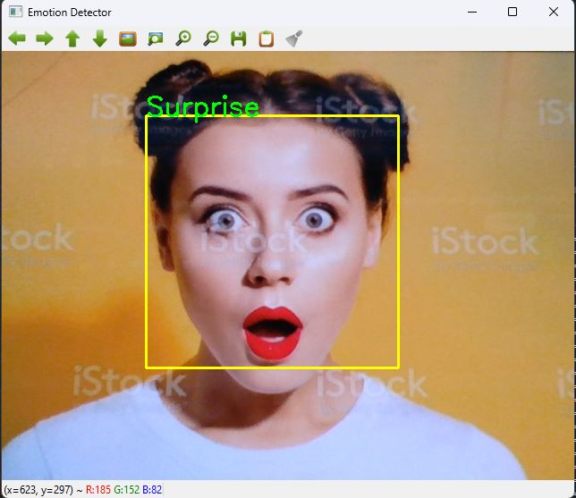
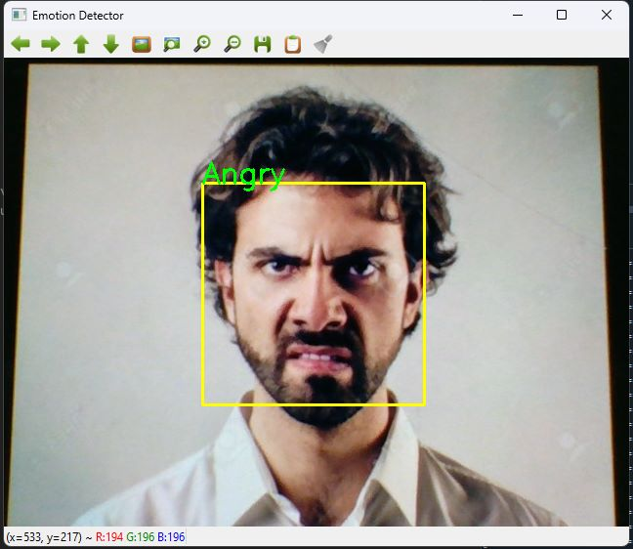
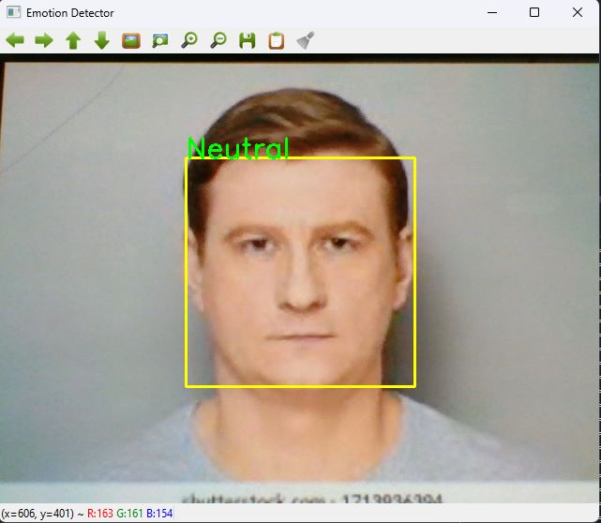
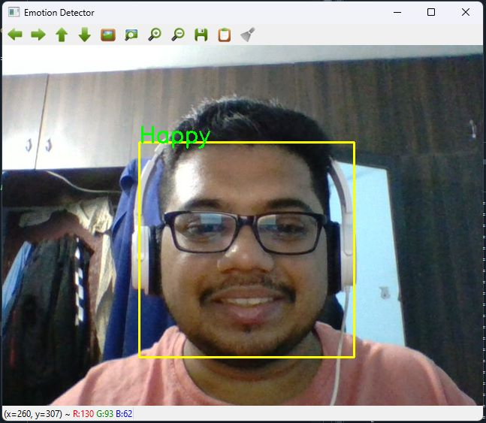
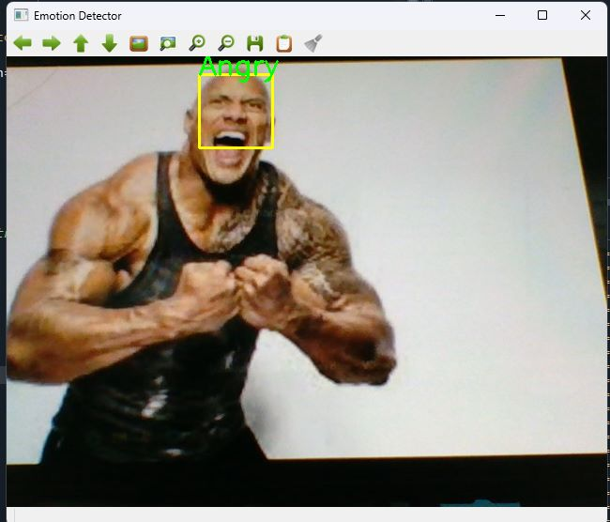
RESULTS AND DISCUSSIONS

Slide 25
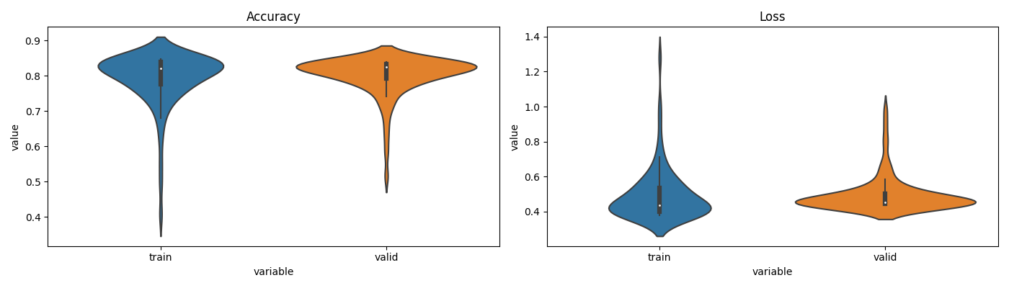
RESULTS AND DISCUSSIONS

Slide 26
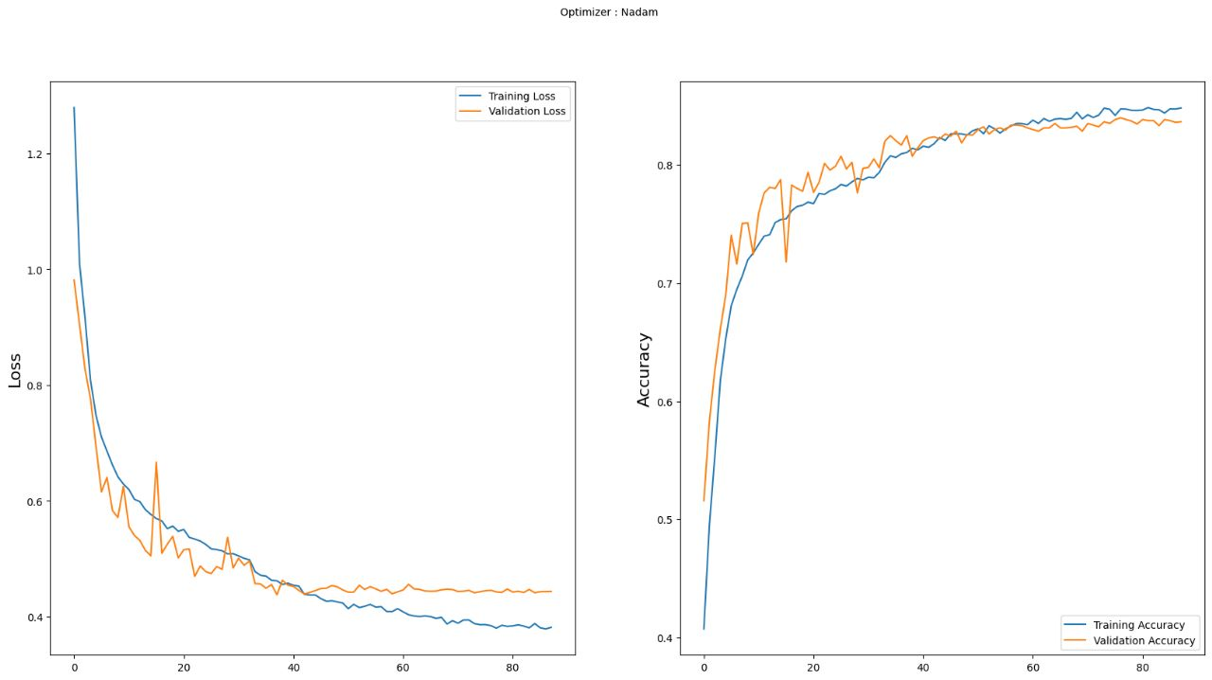
RESULTS AND DISCUSSIONS

Slide 27
National Conference Paper
https://drive.google.com/file/d/1k7KqVdL7uEpG7_TvjE_YF-OvPMPgrppY/view?usp=share_link

Slide 28
CONCLUSIONS
This project aims to utilize the vast amounts of flexibility that Neural network models provide, to enhance the means used for detecting and classifying emotional expressions for helping young patients diagnosed with ASD.
The primary problem of being able to determine the baseline behavior of a child with ASD and interpret their emotions on a contextual basis is solved through the proposed system by personalizing the detection system on a case-by-case basis.
The usage of DCNN will allow the proposed system to learn long-term dependencies between detected expressions and the emotional state of people around the child.
The proposed system also aims to simplify the process of helping children with ASD in understanding the Emotional state of the people surrounding them by clearly showing the child what kind of emotion a person is exhibiting.

Slide 29
FUTURE ENHANCEMENTS
Optimizing the application to run on lower-powered systems to increase accessibility.
Designing a system to monitor the environment over the long term to generate larger personal datasets aiding in generating a more accurate model which can account for growth and mental development.
Establish a larger number of classifications for emotions other than the standard emotions in order to increase the sensitivity of the system to minute changes in detected facial expressions.
Design and Develop a fully end-to-end software and hardware framework that can be easily used.
Explore the use of transfer learning to enhance the base - model and retrain for different use cases of classification that can be used for training children with ASD.

Slide 31


